Slide 1

Natural language processing

Slide 2
Presented To:
Dipanita Saha
Assistant Professor
IIT, NSTU
Presented By:
Al Shahriar Priyo (ASH1825020M)
Rahat Uddin Azad(ASH1825022M)
Mahfuzur Miraz(ASH1825024M)
Moonmoon Das (BKH1825027F)
Al Jaber(ASH1825029M)
Saifur Rahman (ASH1825031M)
01

Slide 3
Natural language processing
Natural language processing (NLP) is the ability of a computer program to understand human language as it is spoken and written -- referred to as natural language.
NLP enables computers to understand natural language as humans do.
Natural language processing uses artificial intelligence to take real-world input, process it, and make sense of it in a way a computer can understand.
Example: Google Assistant
There are two main reasons why we want our computer agents to be able to process natural languages:
to communicate with humans
to acquire information from written language
02

Slide 4
Language Models
An agent that wants to do knowledge acquisition needs to understand messy languages that humans use.
Information-seeking tasks: text classification, information retrieval, and information extraction.
Natural languages are also ambiguous. we cannot speak of a single meaning for a sentence, but rather of a probability distribution over possible meanings.
Natural languages are difficult to deal with because they are very large, and constantly changing.
03

Slide 5
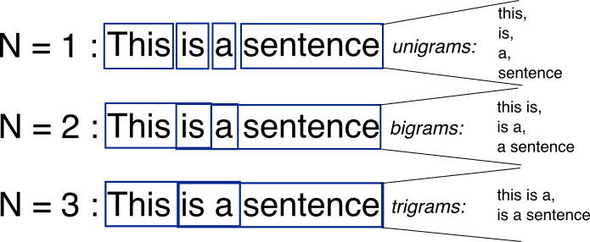
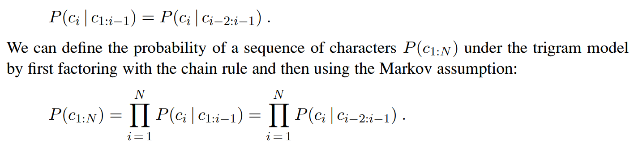
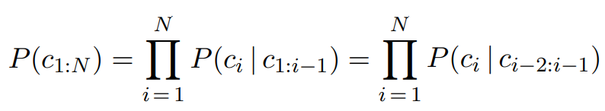
N-gram character models
One of the simplest language models is a probability distribution over sequences of characters. We can write P(c1:N ).
A model of the probability distribution of n-letter sequences is thus called an n-gram model.
An n-gram model is defined as a Markov chain of order n − 1.
Markov chain the probability of character ci depends only on the immediately preceding characters, not on any other characters. So in a trigram model (Markov chain of order 2)
04

Slide 6
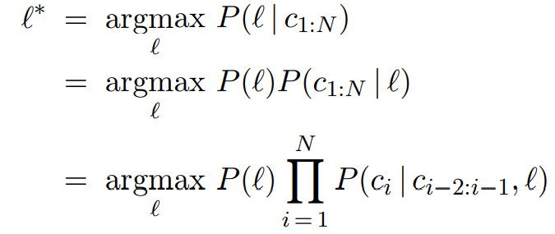
What can we do with n-gram character models?
Language identification: given a text, determine what natural language it is written in.
"Hello, world" or "Wie geht es dir,"
Computer systems identify languages with greater than 99% accuracy.
First build a trigram character model of each candidate language, P(ci|ci−2:i−1,l), where the variable L ranges over languages.
For each the model is built by counting trigrams in a corpus of that language. That gives us a model of P(Text | Language)
But we want to select the most probable language given the text
05

Slide 7

what about the prior probability P(l)?
If we are selecting a random Web page we know that English is the most likely language and that the probability of Macedonian will be less than 1%.
The exact number we select for these priors is not critical because the trigram model usually selects one language that is several orders of magnitude more probable than any other.
06

Slide 8
Smoothing n-gram models
N-gram models provides only an estimate of the true probability distribution.
For common character sequences such as “th” any English corpus will give a good estimate: about 1.5% of all trigrams.
On the other hand, "ht“ is very uncommon no dictionary words start with “ht”.
We want our language models to generalize well to texts they haven’t seen yet.
Just because we have never seen http before does not mean that our model should claim that it is impossible.
Laplace smoothing also called add-one smoothing.
07

Slide 9
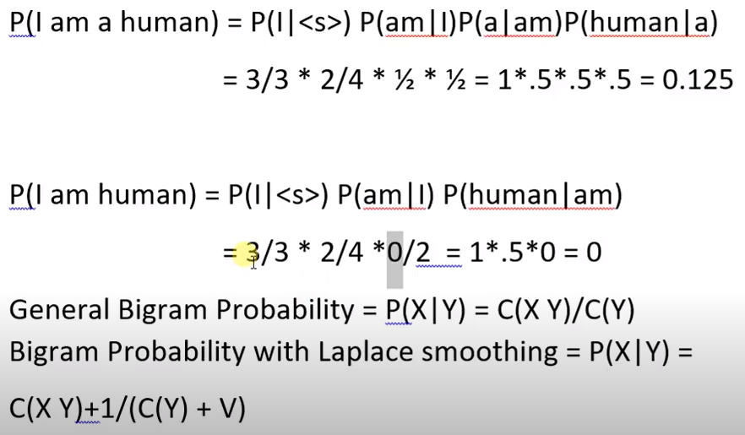
Laplace smoothing
08

Slide 10
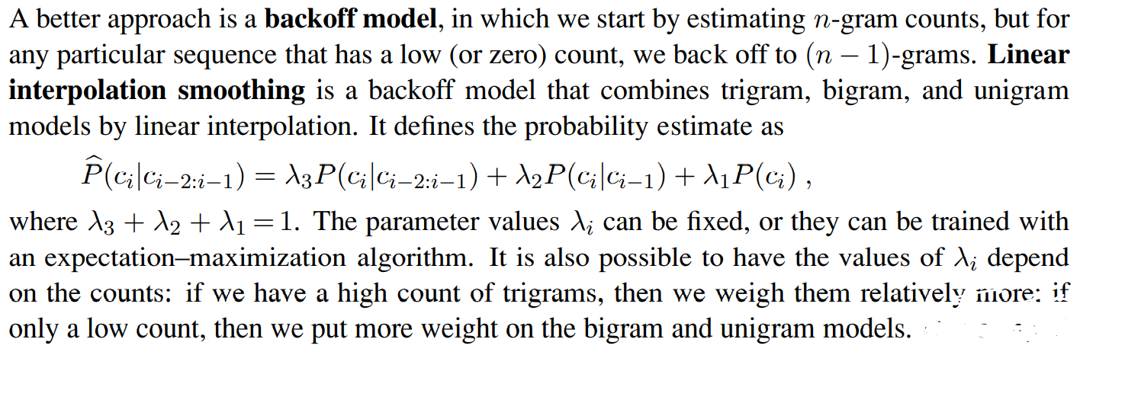
BACKOFF MODEL
09

Slide 11
Model evaluation
We can evaluate a model with cross-validation.
Split the corpus
Validation corpus
Determine the parameters
Evaluate the model
Measuring accuracy
Alternatively we can have a task-independent model of language quality:
calculate the probability
higher the probability is better
10

Slide 12

Model evaluation
Perplexity can be thought of as the reciprocal of probability, normalized by sequence length.
It can also be thought of as the weighted average branching factor of a model.
Suppose there are 100 characters in our language, and our model says they are all equally likely. Then for a sequence of any length, the perplexity will be 100.
If some characters are more likely than others, and the model reflects that, then the model will have a perplexity less than 100.
11

Slide 13
N-Gram Word Models
All the same mechanism VOCABULARY applies equally to word and character models. The main difference is that the vocabulary— the set of symbols that make up the corpus and the model—is larger.
Since units are open, out of vocabulary becomes a problem
“Word” needs to be defined precisely
12

Slide 14
N-gram Word Model Examples
Lets say, There is a sentence, “The sun is shinning”
Unigram: [‘The’, ‘sun’, ‘is’, ‘shinning’]
Bigram: [‘The sun’, ‘ sun is’, ‘is shinning’]
Trigram: [‘The sun is’, ‘sun is shinning’]
13

Slide 15
N-gram Word Models
The models agree with this assessment: the perplexity was 891 for the unigram model, 142 for the bigram model and 91 for the trigram model.
Unigram: logical are as are confusion a may right tries agent goal the was ...
Bigram: systems are very similar computational approach would be represented ...
Trigram: planning and scheduling are integrated the success of naive bayes model is …
14

Slide 16


Text classification
For spam detection text classification, also known as categorization is highly used. Also for language detection.
BAG OF WORDS
FEATURE SELECTION
15

Slide 17

Bag of Words
Out of vocabulary
M1: hi there
M2: who are you
Test: where are you
x1 | hi
x2 | there
x3 | who
x4 | are
x5 | you
 | m1 | m2
x1 | 1 | 0
x2 | 1 | 0
x3 | 0 | 1
x4 | 0 | 1
x5 | 0 | 1
 | test
x1 | 0
x2 | 0
x3 | 0
x4 | 1
x5 | 1
‘hi’, 'are’, ‘there’, ‘who’, ‘you’
Selected Features
Training data
16

Slide 18

What Is Information Retrieval??
INFORMATION RETRIEVAL
Information retrieval is the task of finding documents that are relevant to a user’s need for information.
It informs the existence and location of documents that might consist of the required information. The documents that satisfy user’s requirement are called relevant documents. A perfect IR system will retrieve only relevant documents.
17

Slide 19
Why Information Retrieval (IR)??
Information retrieval is a key technology for knowledge management
IR
Every online database, every search engine, everything that is searched online is based in some way or another on principles developed in IR .
IR is at the heart of searching used in systems such as DIALOG, LexisNexis & others.
Understanding the basics of IR is a prerequisite for understanding how searching of online systems works.
18

Slide 20
Characteristic Of Information Retrieval
01
A corpus of documents
02
Queries posed in a query language
CHARACTERISTIC
03
A result set
04
A presentation of the result set
19

Slide 21
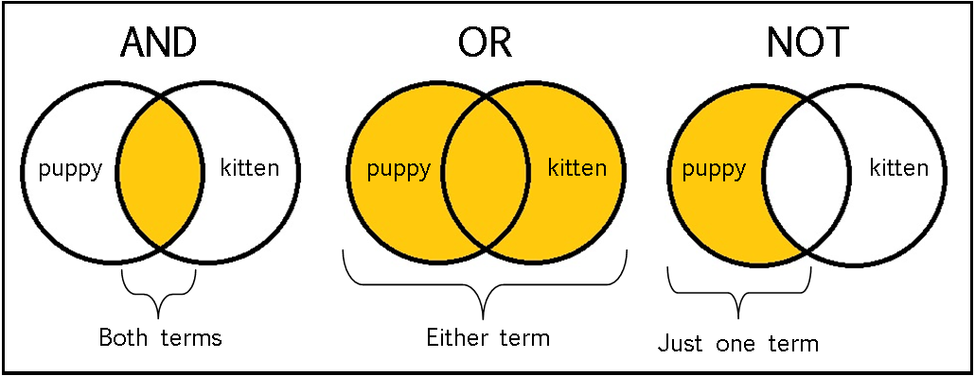
Boolean Keyword Model
The earliest IR systems worked on a Boolean keyword model.
Each word in the document collection is treated as a Boolean feature that is true of a document if the word occurs in the document and false if it does not.
The query language is the language of Boolean expressions over features A document is relevant only if the expression evaluates to true
20

Slide 22
Boolean Keyword Model
01
Advantage
02
Disadvantage
The simplest model, which is based on sets.
Easy to understand and implement.
It only retrieves exact matches
It gives the user, a sense of control over the system.
Boolean expressions are unfamiliar to users who are not programmers or logicians.
It can be hard to formulate an appropriate query, even for a skilled user.
The degree of relevance of a document is a single bit
21

Slide 23
IR Scoring Functions
Most IR systems have abandoned the Boolean model and use models based on the statistics of BM25 SCORING FUNCTION word counts. The BM25 scoring function, which comes from the Okapi project of Stephen Robertson and Karen Sparck Jones at London’s City College, and has been used in search engines such as the open-source Lucene project.
Okapi BM25
22

Slide 24
BM25 Scoring Function
A scoring function takes a document and a query and returns a numeric score. In the BM25 function, the score is a linear weighted combination of scores. Three factors affect the weight of a query term
01
TF for term frequency
02
IDF
The frequency with which a query term appears in a document
The inverse document frequency of the term
03
The length of the document.
04
Combine
A million-word document will probably mention all the query words, but may not actually be about the query. A short document that mentions all the words is a much better candidate.
The BM25 function takes all three of these into account.
23

Slide 25
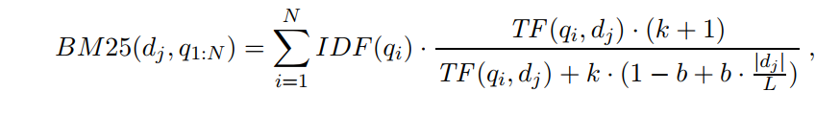

Equation
Lets assume we have created an index of the N documents in the corpus so that we can look up
TF(q_{i}, d_{j}), the count of the number of times word qi appears in document d_{j}. We also assume a table of document frequency counts, DF(q_{i}) , that gives the number of documents that contain the word q_{i}. Then, given a document d_{j} and a query consisting of the words q₁:N, we have
Where,
|d_{j}| is the length of document d_{j} in words,
L is the average document length in the corpus: L = |d_{i}|/N,
We have two parameters, k and b, that can be tuned by
cross-validation; typical values are k = 2.0 and b = 0.75
24

Slide 26
IR System Evaluation
How do we know whether an IR system is performing well?
The answer is using Precision and Recall
Precision
Recall
Precision measures the proportion of documents in the result set that are actually relevant.
Recall measures the proportion of all the relevant documents in the collection that are in the result set.
Relevant In result set
Relevant In result set
꞊
꞊
Relevant
In result & Not in result set
Relevant &
Not relevant In result set
25

Slide 27
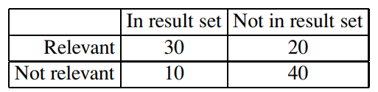
IR System Evaluation: Example
A good IR procedure should have both of them high
꞊
30
꞊
30
Precision
Recall
30+10
30+20
꞊
꞊
0.75
0.60
26

Slide 28
IR Refinements
6
Considering metadata
5
Recognize synonyms
4
Stemming algorithm
3
Case folding
2
BM25 scoring function
1
Pivoted document length normalization scheme
27

Slide 29
Page Rank Algorithm
PageRank (PR) is an algorithm used by Google Search to rank websites in their search engine results. PageRank was named after Larry Page, one of the founders of Google.
PageRank is a way of measure importance of the web pages to be shown according to the searches.
It is not the only algorithm used by Google to order search engine results, but it is the first algorithm that was used by the company and it is best-known.
28

Slide 30
Page Rank Algorithm
How it works
PageRank works by counting the number and quality of links to a page to determine a rough estimate of how important the website is. The underlying assumption is that more important websites are likely to receive more links from other websites.
Example
if the query is [IBM], how do we make sure that IBM’s home page, ibm.com, is the first result, even if another page mentions the term “IBM” more frequently? The idea is that ibm.com has many in-links (links to the page), so it should be ranked higher
29

Slide 31

Page Rank Algorithm
Equation Explanation
PR(p) = PageRank of page p
N = Number of total pages in corpus
PR(in_{i}) = Pages that link to own website
C(in_{i}) = Number of pages that out link of website
30

Slide 32
HITC Algorithm
The Hyperlink-Induced Topic Search algorithm, also known as “Hubs and Authorities” or HITS
Both PageRank and HITS play an important role in understanding of web information retrieval
These algorithms and their extensions are used in ranking billions of queries daily as search engines steadily to develop better
31

Slide 33
HITC Algorithm
1
Each page in this set is considered an authority on the query to the degree that other HUB pages in the relevant set point to it.
01
03
2
Given a query, HITS first finds a set of pages that are relevant to the query. It does that by intersecting hit lists of query words, and then adding pages in the link neighborhood of these pages—pages that link to or are linked from one of the pages in the original relevant set.
02
A page is considered a hub to the degree that it points to other authoritative pages in the relevant set.
32

Slide 34
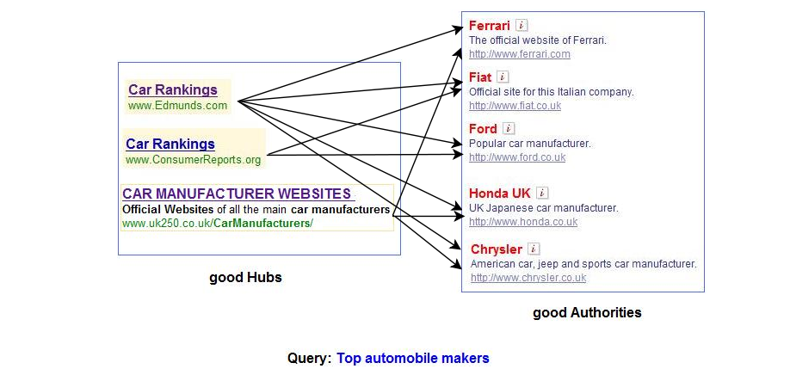
<number>
HITC Algorithm

Slide 35


Question Answering
Question answering (QA) is a computer science discipline within the fields of information retrieval and natural language processing (NLP), which is concerned with building systems that automatically answer questions posed by humans in a natural language.
Question answering is very dependent on a good search corpus—for without documents containing the answer, there is little any question answering system can do.
33

Slide 36
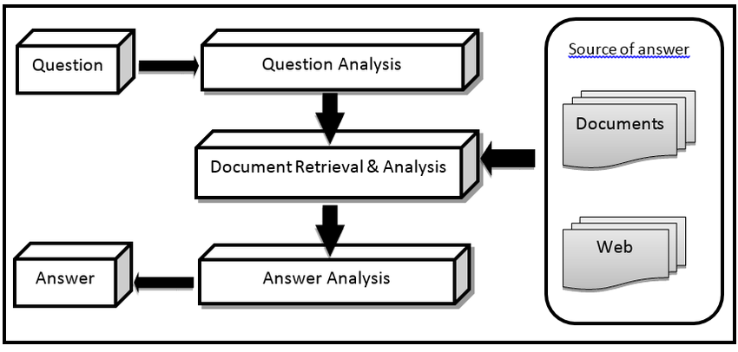
Question Answering
34

Slide 37
Information Extraction
35

Slide 38

What is IE?
Information Extraction (IE) is the task of automatically extracting structured information from unstructured or semi-structured machine-readable documents.
It is the process of scanning text for relevant information to some interest.
Information Extraction (IE) tools make it possible to pull information from text documents, databases, websites or multiple sources.
36

Slide 39
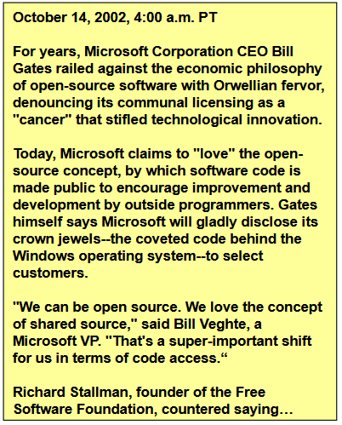
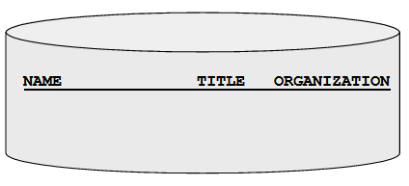
What is IE? (con..)
Task: Filling slots in a database from sub-segments of text.
37

Slide 40
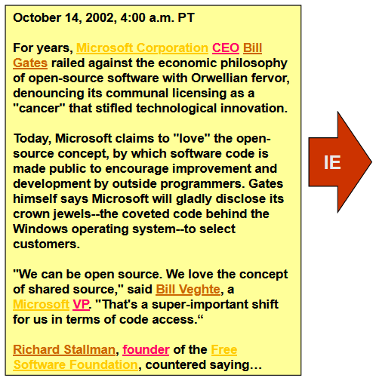
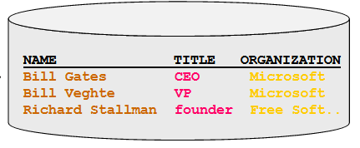
What is IE? (con..)
Task: Filling slots in a database from sub-segments of text.
38

Slide 41
Finite-State Automata For Information Extraction
39

Slide 42
Attribute and Relational Based extraction System
The simplest type of information extraction system is an attribute-based extraction system.
“IBM ThinkBook 970. Our price: $399.00”
The set of attributes {Manufacturer=IBM, Model=ThinkBook970, Price=$399.00}
The template is defined by a finite state automaton, the simplest example of which is the regular expression or regex.
Regular expressions are used in Unix commands such as grep, in programming languages such as Perl, and in word processors such as Microsoft Word.
Templates are often defined with three parts: a prefix regex, a target regex, and a postfix regex.
40

Slide 43
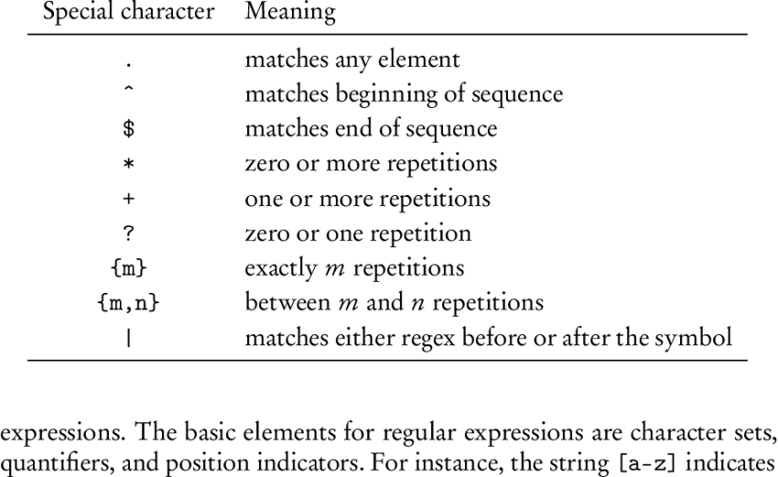
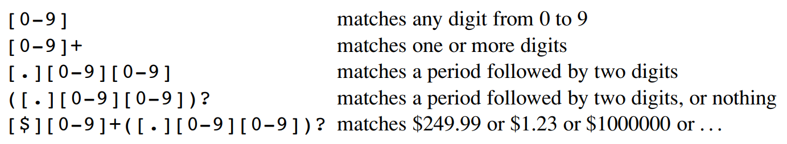
Regular Expression Template
41

Slide 44
FASTUS is a system for extracting information from natural language text for entry into a database and for other applications.
IE With FASTUS: A Cascade Finite-state Transducers
Tokenization
01
Complex-word handling
02
Basic-group handling
03
Complex-phrase handling
04
Structure merging
05
42

Slide 45
Segments the stream of characters into tokens (words, numbers, and punctuation).
For English, tokenization can be fairly simple; just separating characters at white space or punctuation does a fairly good job.
Some tokenizers also deal with markup languages such as HTML, SGML, and XML.
Tokenization
43

Slide 46
Identify multiwords, company names, people names, locations, dates, times and basic entities.
Recognition strategies:
Patterns
Dictionaries
Context
Multiwords such as ''set up'', ''trading house'', ''new Taiwan dollars'', and ''joint venture''
Company names like ''Bridgestone Sports Co.'' and ''Bridgestone Sports Taiwan Co.''
For example, a company name might be recognized by the rule
CapitalizedWord+ (“Company” | “Co” | “Inc” | “Ltd”)
Complex-word handling
44

Slide 47
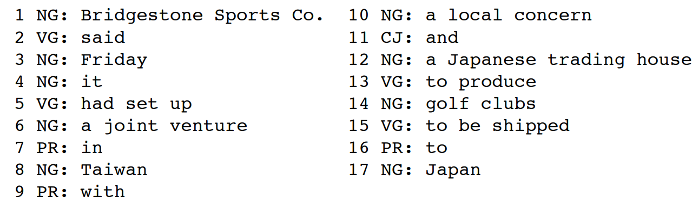
Noun Group
Some syntactic constructs can be identified with reasonable reliability:
Noun group
Verb group
Syntactic Chunking
Verb Group
Basic-group handling
Text: “Bridgestone Sports Co. said Friday it has set up a joint venture in Taiwan with a local concern and a Japanese trading house to produce golf clubs to be shipped to Japan”
Here NG means noun group, VG is verb group, PR is preposition, and CJ is conjunction.
45

Slide 48
Recognize complex noun and verb groups
Complex noun groups
Appositives
Measure phrases
Prepositional attachments (of, for)
Noun group conjunction
Complex verb groups
Verb conjunction
Verb groups with same significance
Domain-relevant entities can be recognized
Example : The joint venture, Bridgestone Sports Taiwan Co.
Complex-phrase handling
46

Slide 49
Previous stages operate within bounds of single sentences.
Operate over whole text to combine previous collected information into a unified whole.
If recognizing multiple events:
Determine how many distinct events
Assign each entity to appropriate even
Structure merging
47

Slide 50
Probabilistic Models For Information Extraction
48

Slide 51
Hidden Markov Model (HMM)
Hidden Markov Model (HMM) is a statistical Markov model in which the system being modeled is assumed to be a Markov process with unobserved (“Hidden”) state.
HMMs have two big advantages over FSAs for extraction.
First, HMMs are probabilistic, and thus tolerant to noise. In a regular expression, if a single expected character is missing, the regex fails to match; with HMMs there is graceful degradation with missing characters/words, and we get a probability indicating the degree of match, not just a Boolean match/fail.
Second, HMMs can be trained from data; they don’t require laborious engineering of templates, and thus they can more easily be kept up to date as text changes over time.
49

Slide 52


Hidden Markov Model (HMM)
Julia
Sam
50

Slide 53
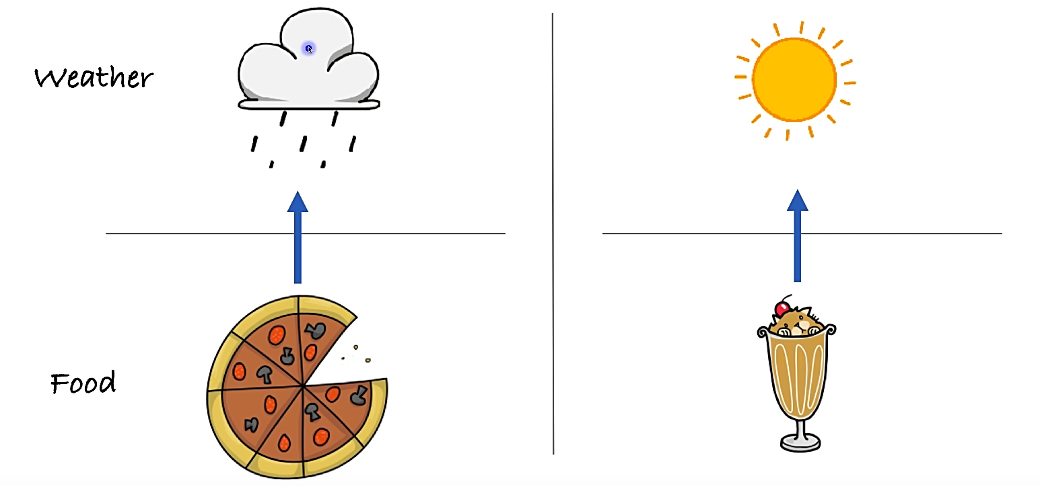
Hidden Markov Model (HMM)
51

Slide 54
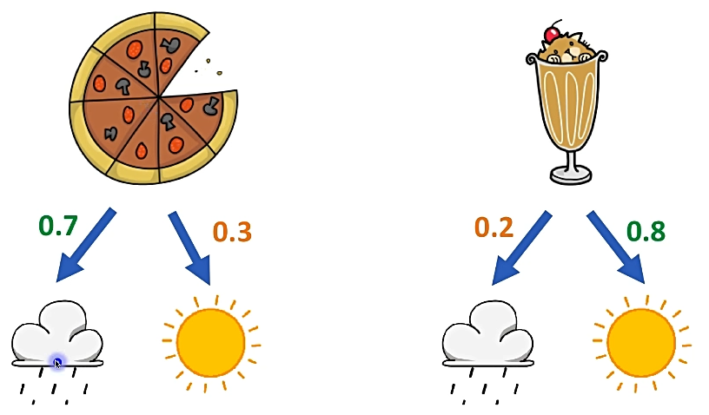
Hidden Markov Model (HMM)
52

Slide 55
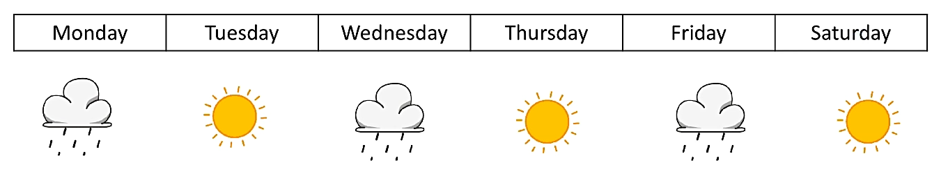
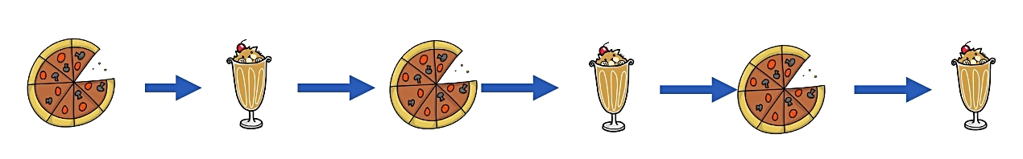
Hidden Markov Model (HMM)
53

Slide 56
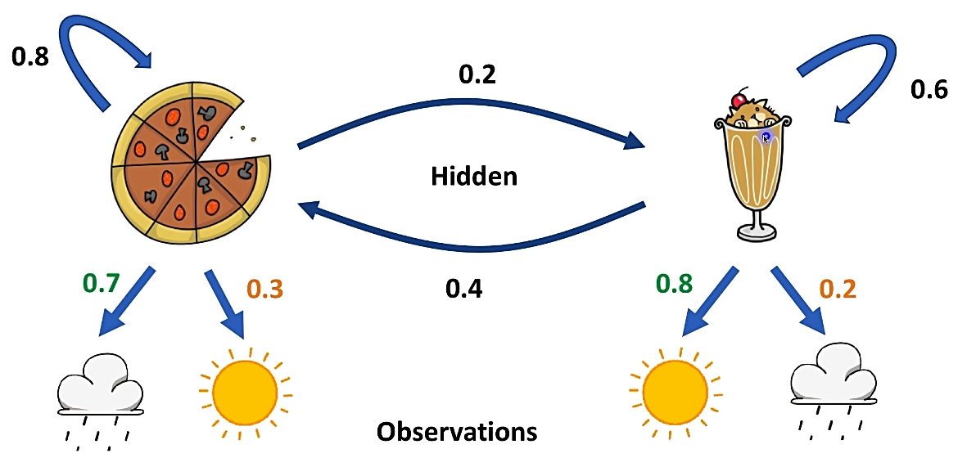
Hidden Markov Model (HMM)
54

Slide 57
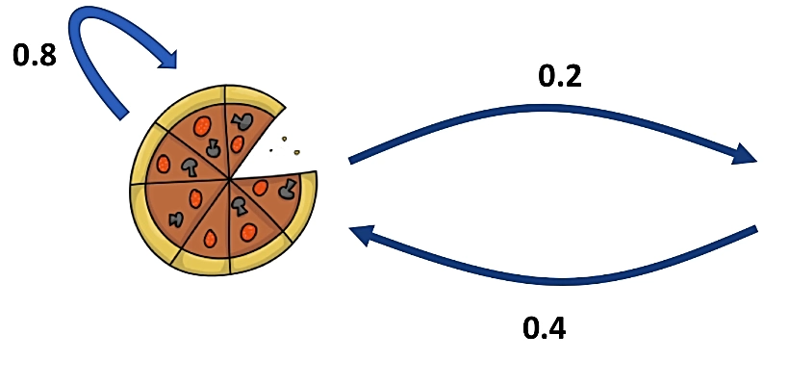
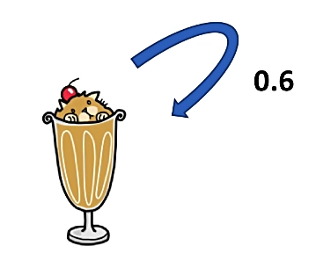
Transition Probabilities
55

Slide 58
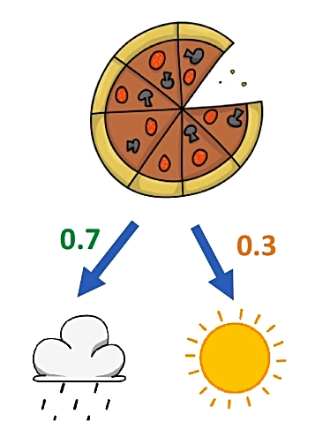
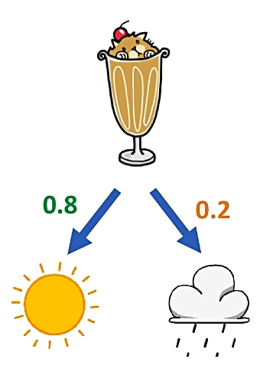
Emission Probabilities
56

Slide 59
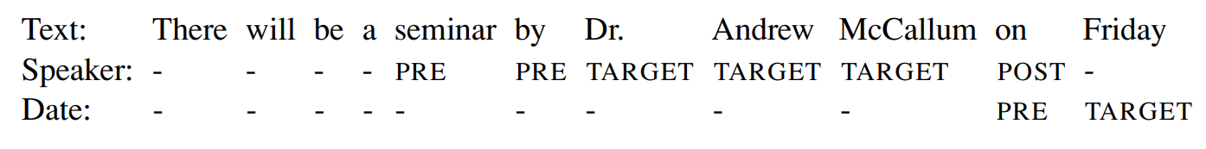
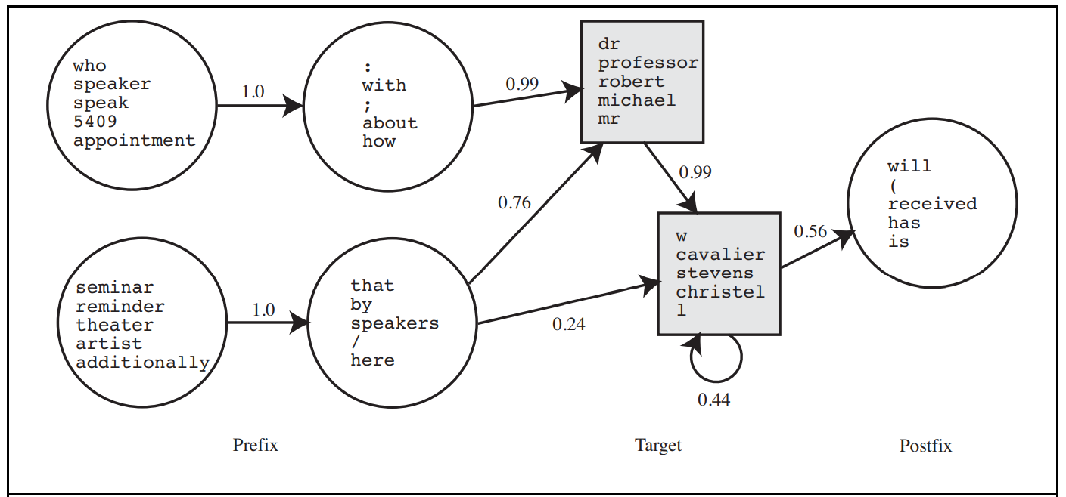
Figure-01: Hidden Markov model for the speaker of a talk announcement. The two square states are the target (note the second target state has a self-loop, so the target can match a string of any length), the four circles to the left are the prefix, and the one on the right is the postfix. For each state, only a few of the high-probability words are shown.
57

Slide 60
Conditional Random Fields For Information Extraction
58

Slide 61
The CRF Model
CRFs(conditional random fields) is a popular probabilistic method for structured prediction.
Common funda behind many applications is the ability to predict multiple variables that depend on each other.
One issue with HMMs for the information extraction task is that they model a lot of probabilities that we don’t really need. An HMM is a generative model.
All we need in order to understand a text is a discriminative model, one that models the conditional probability of the hidden attributes given the observations (the text).
59

Slide 62
In many applications, we want the ability to predict multiple variables that depend on each other. For example, the performance of a sports team depends on the health of each member of the team. The health of each member might get affected by the travel schedule of the team. The results of the game might affect the morale of the team. The morale, in turn, might affect the health. As you can see, there are multiple variables that depend on each other intricately. Conditional Random Fields (CRFs) are very useful in modeling these problems.
Why do we need it?
60

Slide 63
Given a sequence X = [x1, x2, …, xN]
We have to predict the corresponding labels Y = [y1, y2, …, yN]
Step 1: Creation of feature vectors from the given sequence F = [f1, f2, …, fN]
Step 2: Calculate the probability of each possible label yi given a feature vector fi
Step 3: The yi with maximum probability for given feature fi is the label of token xi
Label of xi = argmax( P( yi | fi ) )
Implementation
61

Slide 64
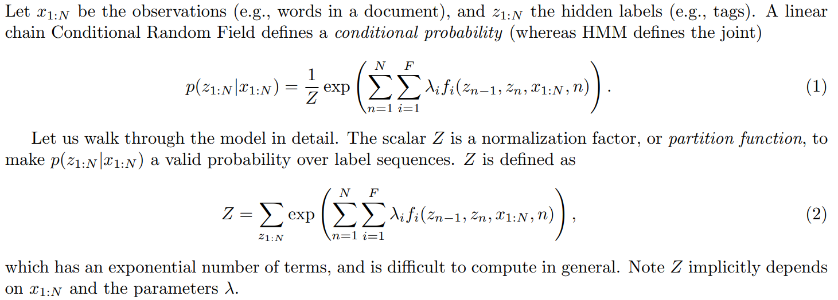
Implementation
62

Slide 65
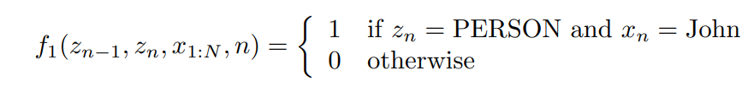
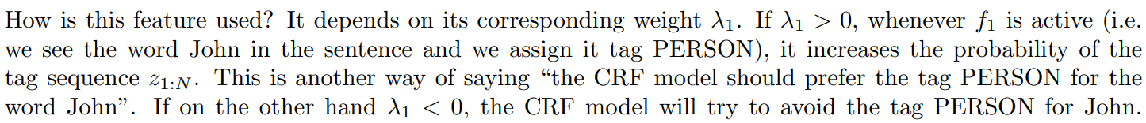
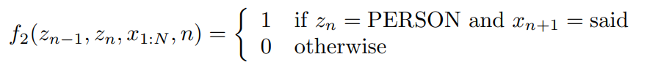
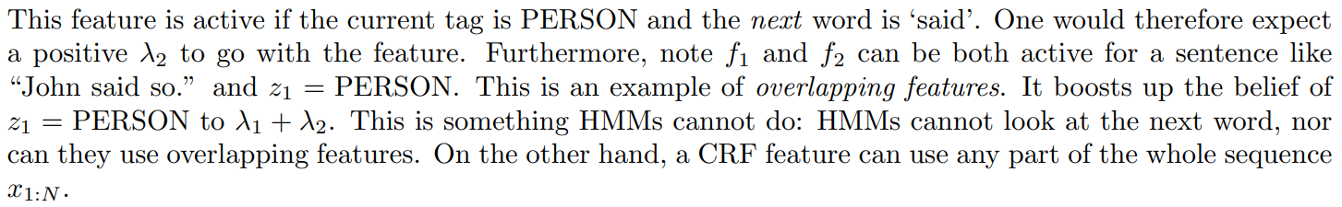
Feature Functions
63

Slide 66
Ontology extraction from large corpora
Ontology : Set of concepts and the relationship between these concepts.
There are three different ways –
1. Open-Ended
2. With a large corpus
3. Results can be statistical
Ontology concentrated on templates that are very general and have high precision
Here is one of the most productive templates:
NP such as NP (, NP)* (,)? ((and | or) NP)? .
The “NP is a NP” template does indeed sometimes denote a subcategory relation.
64

Slide 67
Automated template construction
Brin (1999) started with a data set of just five examples:
(“Isaac Asimov”, “The Robots of Dawn”)
(“David Brin”, “Startide Rising”)
(“James Gleick”, “Chaos—Making a New Science”)
(“Charles Dickens”, “Great Expectations”)
(“William Shakespeare”, “The Comedy of Errors”)
Each match is defined as a tuple of seven strings,
(Author, Title, Order, Prefix, Middle, Postfix, URL)
Given a good set of examples, the system can build a good set of templates.
The biggest weakness in this approach is the sensitivity to noise.
65

Slide 68
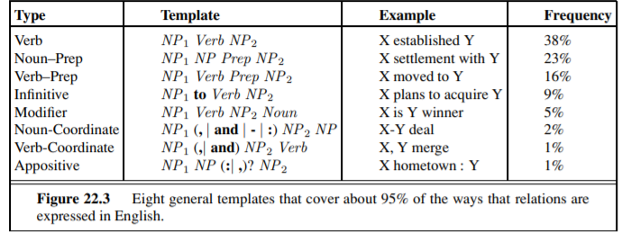
Machine reading
Machine Reading---the automatic, unsupervised understanding of text.
Representative machine-reading system is TEXTRUNNER.
TEXTRUNNER is domain-independent, it cannot rely on predefined lists of nouns and verbs.
66

Slide 69
Thank You!
For your Attentions

